Slide 1
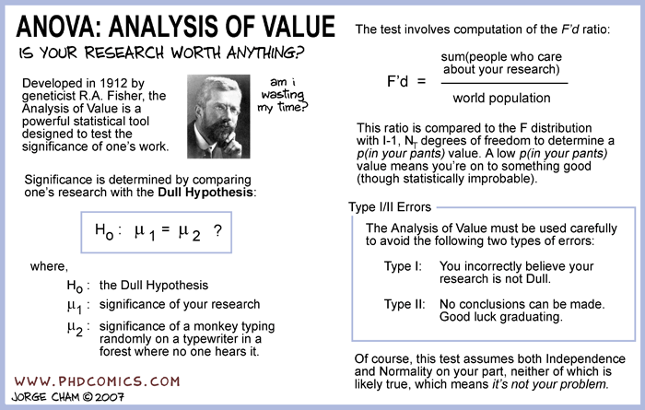
Anova Week 10, class 2
Geog4300/6300
Jerry Shannon

Slide 2
Variablesc | Tests; test statistics; SE
Continuous; one sample: σ known and n > 30 OR data is a proportion | One-sample z-test; Z; SE = σ/sqrt(n); OR Diff. of proportions
Continuous; one sample: σ unknown or n < 30 | One-sample t-test; t; SE = s/sqrt(n-1)
Continuous; two samples | Student’s t-test for difference of means
Continuous; paired samples | Paired t-test
Continuous; more than two samples | ANOVA
Discrete; two variables; counts | Chi-square, goodness of fit
Continuous; two or more variables | Regression
You are here

Slide 3
What if you have THREE OR MORE groups to compare?
Number of pumpkins per block for four random blocks
 | Normaltown | Five Points | East Athens
 | 18.2 | 17.4 | 15.2
 | 20.1 | 18.7 | 15.8
 | 17.6 | 19.1 | 17.7
 | 16.8 | 16.4 | 16.5
Mean | 18.175 | 17.9 | 16.3
Std. Dev. | 1.41 | 1.24 | 1.07
Independent variable?
Dependent variable?
Independent variable: Neighborhood
Dependent variable: # of decorations

Slide 4

What if you have THREE OR MORE groups to compare?
Number of pumpkins per block for four random blocks
 | Normaltown | Five Points | East Athens
 | 18.2 | 17.4 | 15.2
 | 20.1 | 18.7 | 15.8
 | 17.6 | 19.1 | 17.7
 | 16.8 | 16.4 | 16.5
Mean | 18.175 | 17.9 | 16.3
Std. Dev. | 1.41 | 1.24 | 1.07
We could do a bunch of two sample tests, but that’s BORING!

Slide 5
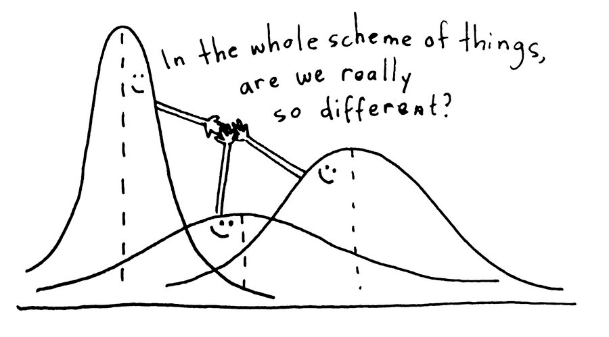
To do this analysis, we conduct an ANOVA (Analysis of Variance) test

Slide 6
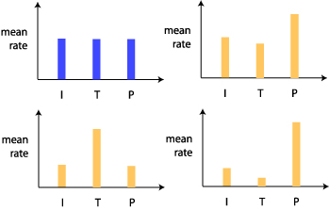
ANOVA establishes there is a difference in the dependent variable for at least one pair of groups
The ANOVA test would be significant in finding a difference for all of these cases except for here

Slide 7
Hypotheses with ANOVA
ANOVA only tells us if group means are statistically equal.
H₀: All group means are equal
H_{A}: The group means are not all equal
It does NOT tell us what way they’re unequal

Slide 8
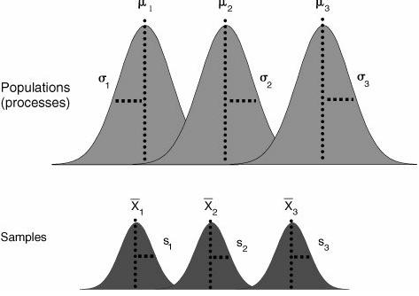
ANOVA compares variance:
The between group variability (distance from obs. to “grand” mean)
VS.
The within group varaibility (distance from obs. to group mean)
Within group variance
The smaller the statistic, the greater probability that the groups are equal.
One observation
Mean of ALL observations-
the “grand mean”
Between group variance

Slide 9
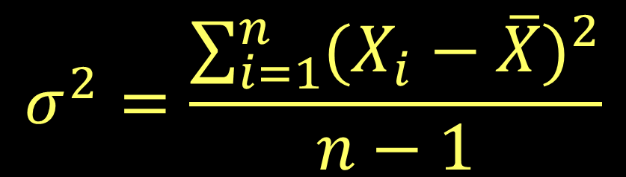
Remember variance?
It’s the average distance between observations and their mean, squared to make it all positive.

Slide 10
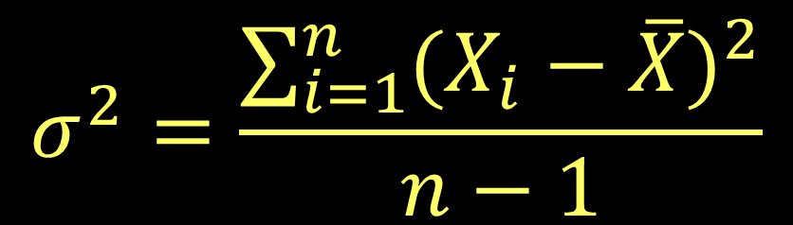
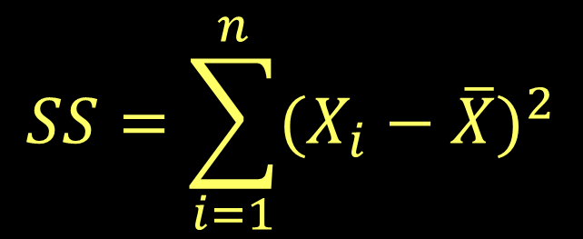
ANOVA uses a similar measure, but removes the averaging part:
This is called the “sum of squares”

Slide 11
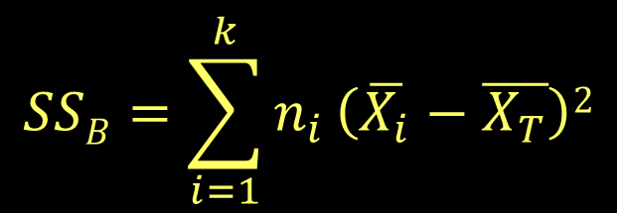
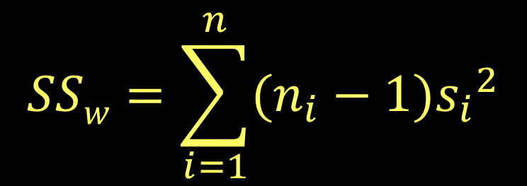
ANOVA does this twice:
SS_{B} = Between group sum of squares
(Variance between group means and the grand mean)
# of obs. in group i
The grand mean
The mean of group i
SS_{W} = Within group sum of squares
(Variance between obs. and the group mean)
n of group i
This figure is calculated once for all observations in all groups
sd of group i

Slide 12
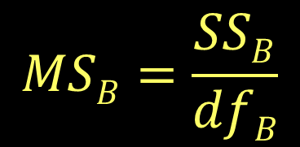
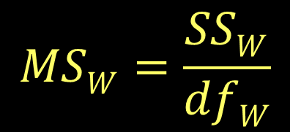
Then create the mean of squares for each variance
Both SS_{B} and SS_{W} have degrees of freedom
df_{B} = Number of groups – 1
df_{W} = Total observations - Number of groups

Slide 13
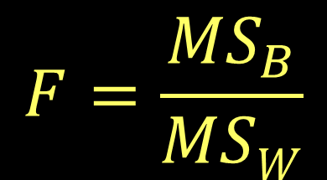
Then create the mean of squares for each variance
The final test statistic (F) is the ratio of these two numbers
Its d.f. = the number of total observations - 1

Slide 14
In this case:
H₀: All neighborhoods have equal # of pumpkins
H_{A}: Neighborhoods have unequal # of pumpkins
Both SS_{B} and SS_{W} have degrees of freedom
df_{B} = Number of groups – 1
df_{W} = Total observations - Number of groups
Our test statistic can be found on a table of F values.
df₁ = df_{B} (2) and df₂ = df_{w} (9).
Here, the critical value is 4.3.

Slide 15
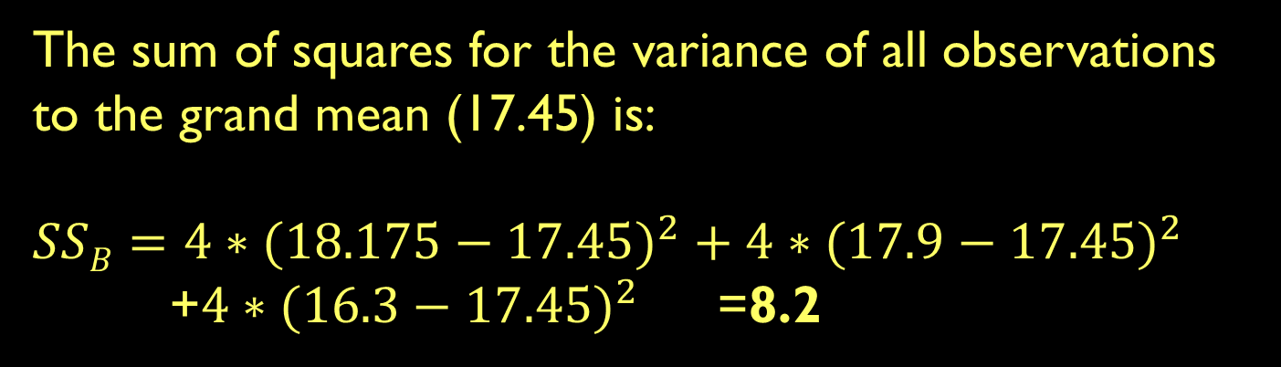
Number of pumpkins per block for four random blocks
 | Normaltown | Five Points | East Athens
 | 18.2 | 17.4 | 15.2
 | 20.1 | 18.7 | 15.8
 | 17.6 | 19.1 | 17.7
 | 16.8 | 16.4 | 16.5
Mean | 18.175 | 17.9 | 16.3
Std. Dev. | 1.41 | 1.24 | 1.07

Slide 16
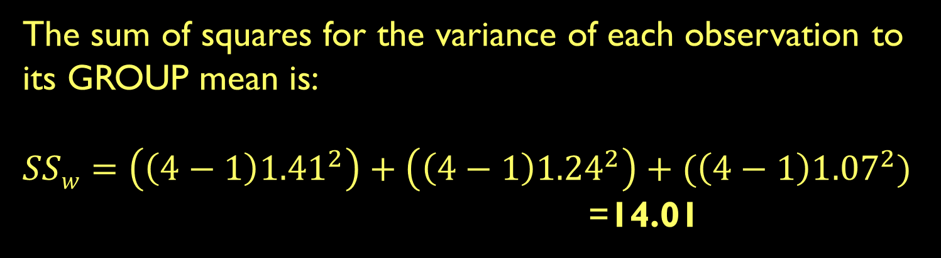
Number of pumpkins per block for four random blocks
 | Normaltown | Five Points | East Athens
 | 18.2 | 17.4 | 15.2
 | 20.1 | 18.7 | 15.8
 | 17.6 | 19.1 | 17.7
 | 16.8 | 16.4 | 16.5
Mean | 18.175 | 17.9 | 16.3
Std. Dev. | 1.41 | 1.24 | 1.07

Slide 17
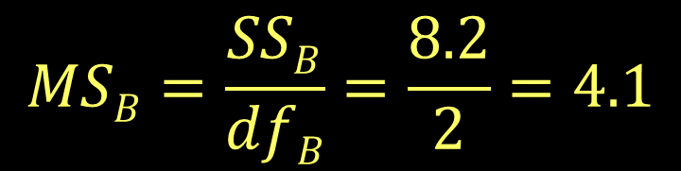
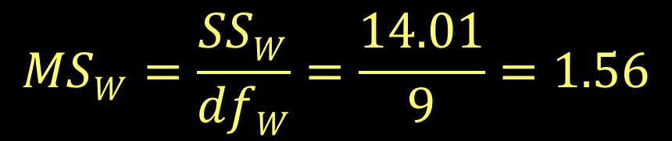
df_{B} = 3 – 1 = 2
df_{W} = 12 – 3 = 9
Number of pumpkins per block for four random blocks
 | Normaltown | Five Points | East Athens
 | 18.2 | 17.4 | 15.2
 | 20.1 | 18.7 | 15.8
 | 17.6 | 19.1 | 17.7
 | 16.8 | 16.4 | 16.5
Mean | 18.175 | 17.9 | 16.3
Std. Dev. | 1.41 | 1.24 | 1.07

Slide 18

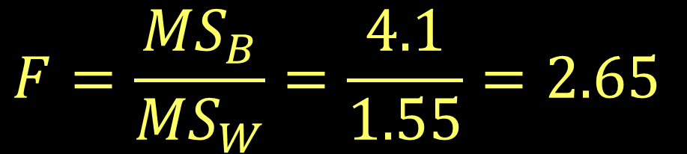
So the test statistic is…
$$F=\frac{{MS}_{B}}{{MS}_{W}}=\frac{4.1}{1.55}=2.65$$
Number of pumpkins per block for four random blocks
Our critical value was 4.3.
The null hypothesis is NOT rejected. These groups are statistically equal.
 | Normaltown | Five Points | East Athens
 | 18.2 | 17.4 | 15.2
 | 20.1 | 18.7 | 15.8
 | 17.6 | 19.1 | 17.7
 | 16.8 | 16.4 | 16.5
Mean | 18.175 | 17.9 | 16.3
Std. Dev. | 1.41 | 1.24 | 1.07

Slide 19

Try out ANOVA in Excel!

Slide 20
Try out ANOVA in Excel!

Slide 21
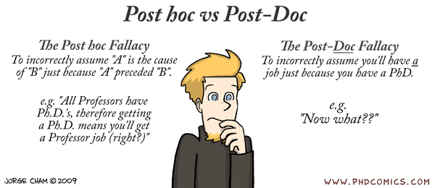
Post hoc tests

Slide 22

Study: Two new drugs to treat anxiety: anxifree and joyzepam. Do either (or both) have a beneficial effect?

Slide 23
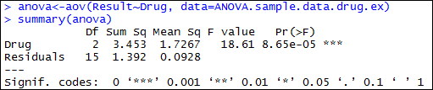
You’ve run an ANOVA analysis that’s come out significant.
NOW WHAT?
Participant | Drug | Therapy | Result
1 | placebo | no.therapy | 0.5
2 | placebo | no.therapy | 0.3
3 | placebo | no.therapy | 0.1
4 | anxifree | no.therapy | 0.6
5 | anxifree | no.therapy | 0.4
6 | anxifree | no.therapy | 0.2
7 | joyzepam | no.therapy | 1.4
8 | joyzepam | no.therapy | 1.7
9 | joyzepam | no.therapy | 1.3
10 | placebo | CBT | 0.6
11 | placebo | CBT | 0.9
12 | placebo | CBT | 0.3
13 | anxifree | CBT | 1.1
14 | anxifree | CBT | 0.8
15 | anxifree | CBT | 1.2
16 | joyzepam | CBT | 1.8
17 | joyzepam | CBT | 1.3
18 | joyzepam | CBT | 1.4

Slide 24
What are the possibilities?
H₀ = All three drugs have equal effects
H_{A} = The drugs have unequal effects
J = A | J = P | A = P | Hypothesis
X | X | X | Null
X |  |  | Alternate
 | X |  | Alternate
 |  | X | Alternate
X | X |  | Alternate
X |  | X | Alternate
 | X | X | Alternate

Slide 25
How do we know which is correct?
Post-hoc tests can check for this
J = A | J = P | A = P | Hypothesis
X | X | X | Null
X |  |  | Alternate
 | X |  | Alternate
 |  | X | Alternate
X | X |  | Alternate
X |  | X | Alternate
 | X | X | Alternate

Slide 26
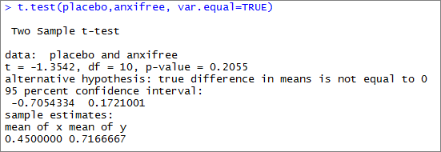
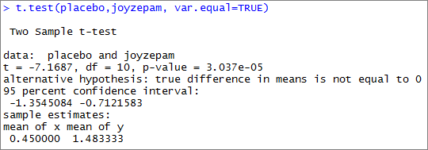
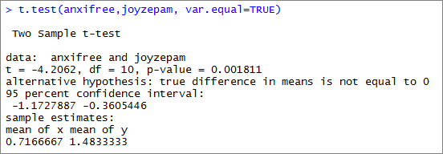
We can run two sample tests on the data

Slide 27
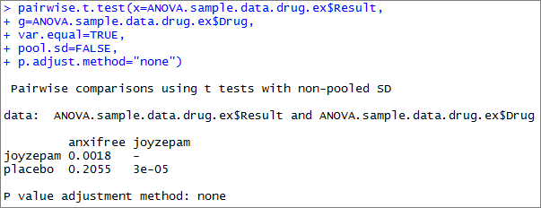
pairwise.t.test does this for all variables

Slide 28
How many different combinations?
n!
x!(n-x)!
3!
2!(3-2)!
=
= 3
What if we had eight groups?
n!
x!(n-x)!
8!
2!(8-2)!
=
= 28
To control for potential false positives, post hoc tests use statistical corrections.

Slide 29
Bonferroni correction:
Multiply the number of tests (m)
by the p-value for each test
For three tests:
3 * 0.0018 = 0.0054
3 * 0.2055 = 0.6165
3 * 0.00003 = 0.00009

Slide 30
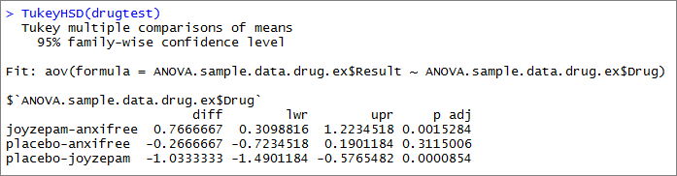
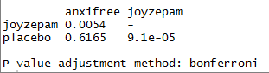
Many people use the Tukey HSD test as a correction. It also adjusts for repeated trials.
Compare with Bonferroni:

Slide 31

In ANOVA and many other tests, it’s important to check our assumptions!

Slide 32
ANOVA makes two assumptions:
The residuals from the ANOVA are normally distributed.
Variance is equal in each of your groups.

Slide 33

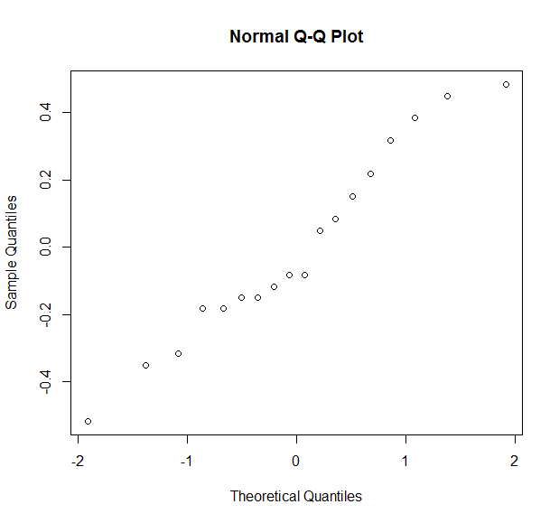
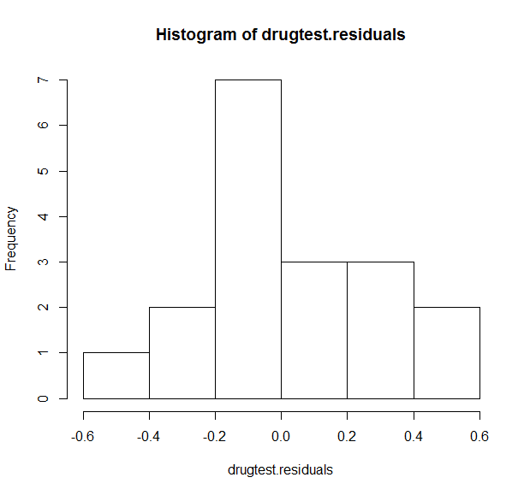
We’ll talk more about residuals with regression. It’s a form of model error.
You can check their normality using R:

Slide 34
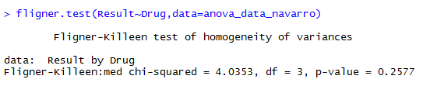
There are several tests for equal variance between groups. The easiest in R is the Fligner-Kileen test.
Remember: H₀ = Variance IS equal.

Slide 35

The Kruskal-Wallis test is a non-parametric version of ANOVA.
Like the Wilcoxon tests, it relies on ordinal rankings of data.
In R, it’s the function “kruskal.test”

Slide 36
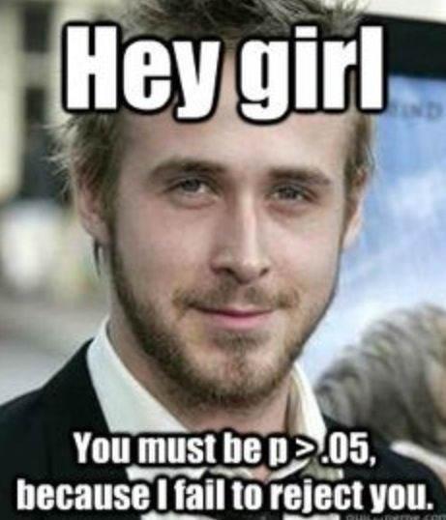
Let’s try it out!

